Slide 1

Currency Trading Platform
Larry Gagnon, Hao Sun, Ganna Kassantini, Geoffrey Falk

Slide 2

Project Goal: Create an easy to use crypto currency analysis & trading platform

Slide 3

Project Objective
Project Objective:
Obtain daily and historical performance data for the top 5 crypto currencies.
Use logistic regression model to analyze the crypto currency data.
Create a small app that allows users to buy/sell one of the five crypto currencies.
Add a portfolio summary function to the buy/sell app.
Publish a crypto trading platform app with Streamlit.
Publish rss news on the home page.
Create Crypto Conversion Calculator.

Slide 4

Data sources
We used yfinance, coincap api, rss feeds.

Slide 5

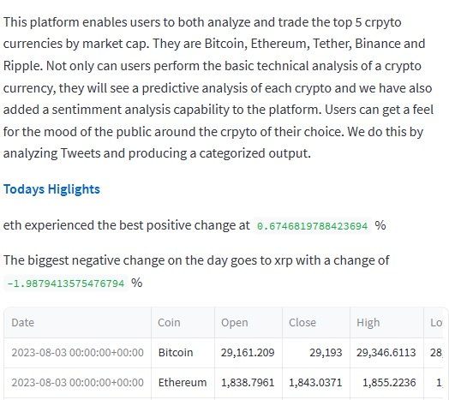
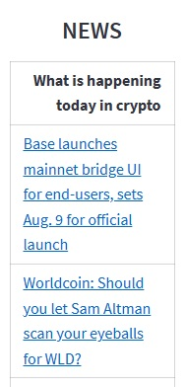
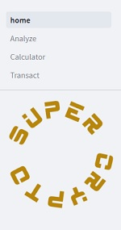
Main Page

Slide 6
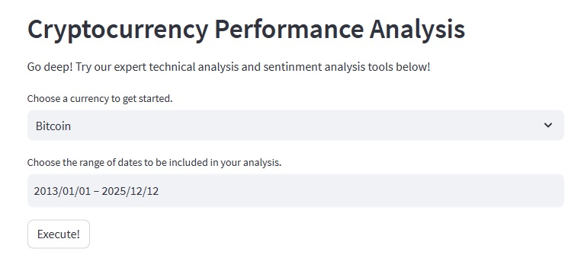
Analyze Page

Slide 7
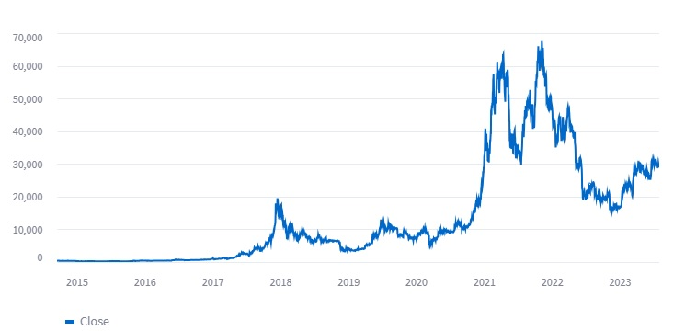

Slide 8
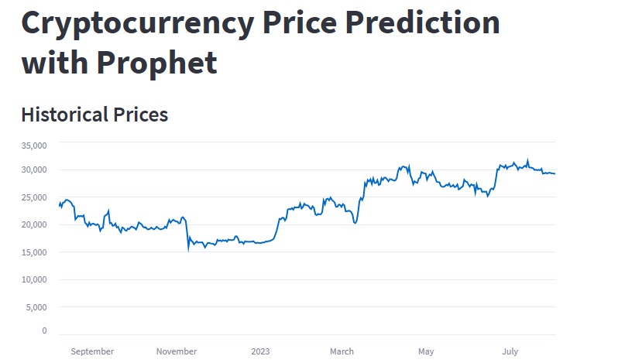

Slide 9
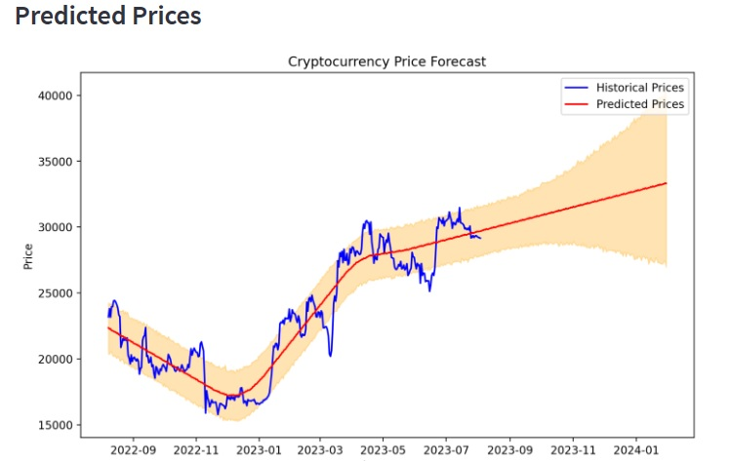

Slide 10
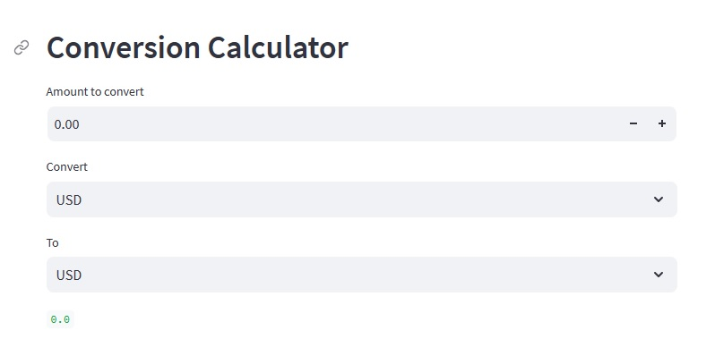

Slide 11
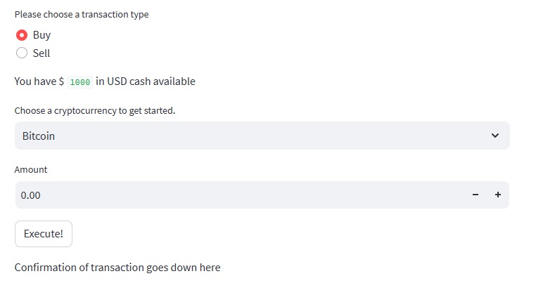
Transact Page

Slide 12
Obstacles:
Future Development:
Live transactions
Sentiment analysis
Identity and Access Management ( portfolio)
Link to Github: Project-3/Home.py at main · Forensicom/Project-3 (github.com)

